Slide 1
16 February 2024
Milestone 1: Design, Accomplishments, and Solutions
Ashwin Chembu, Ruohan Huang, Trevor Lash, Mira Stenger, Yuecheng Zhao

Slide 2
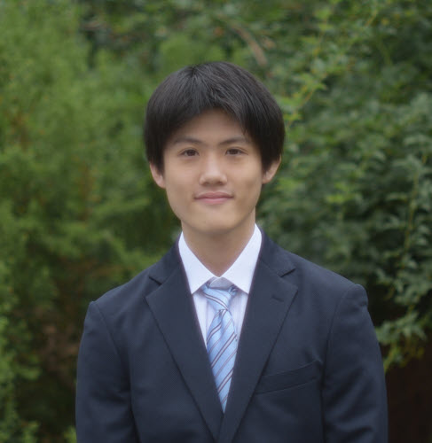

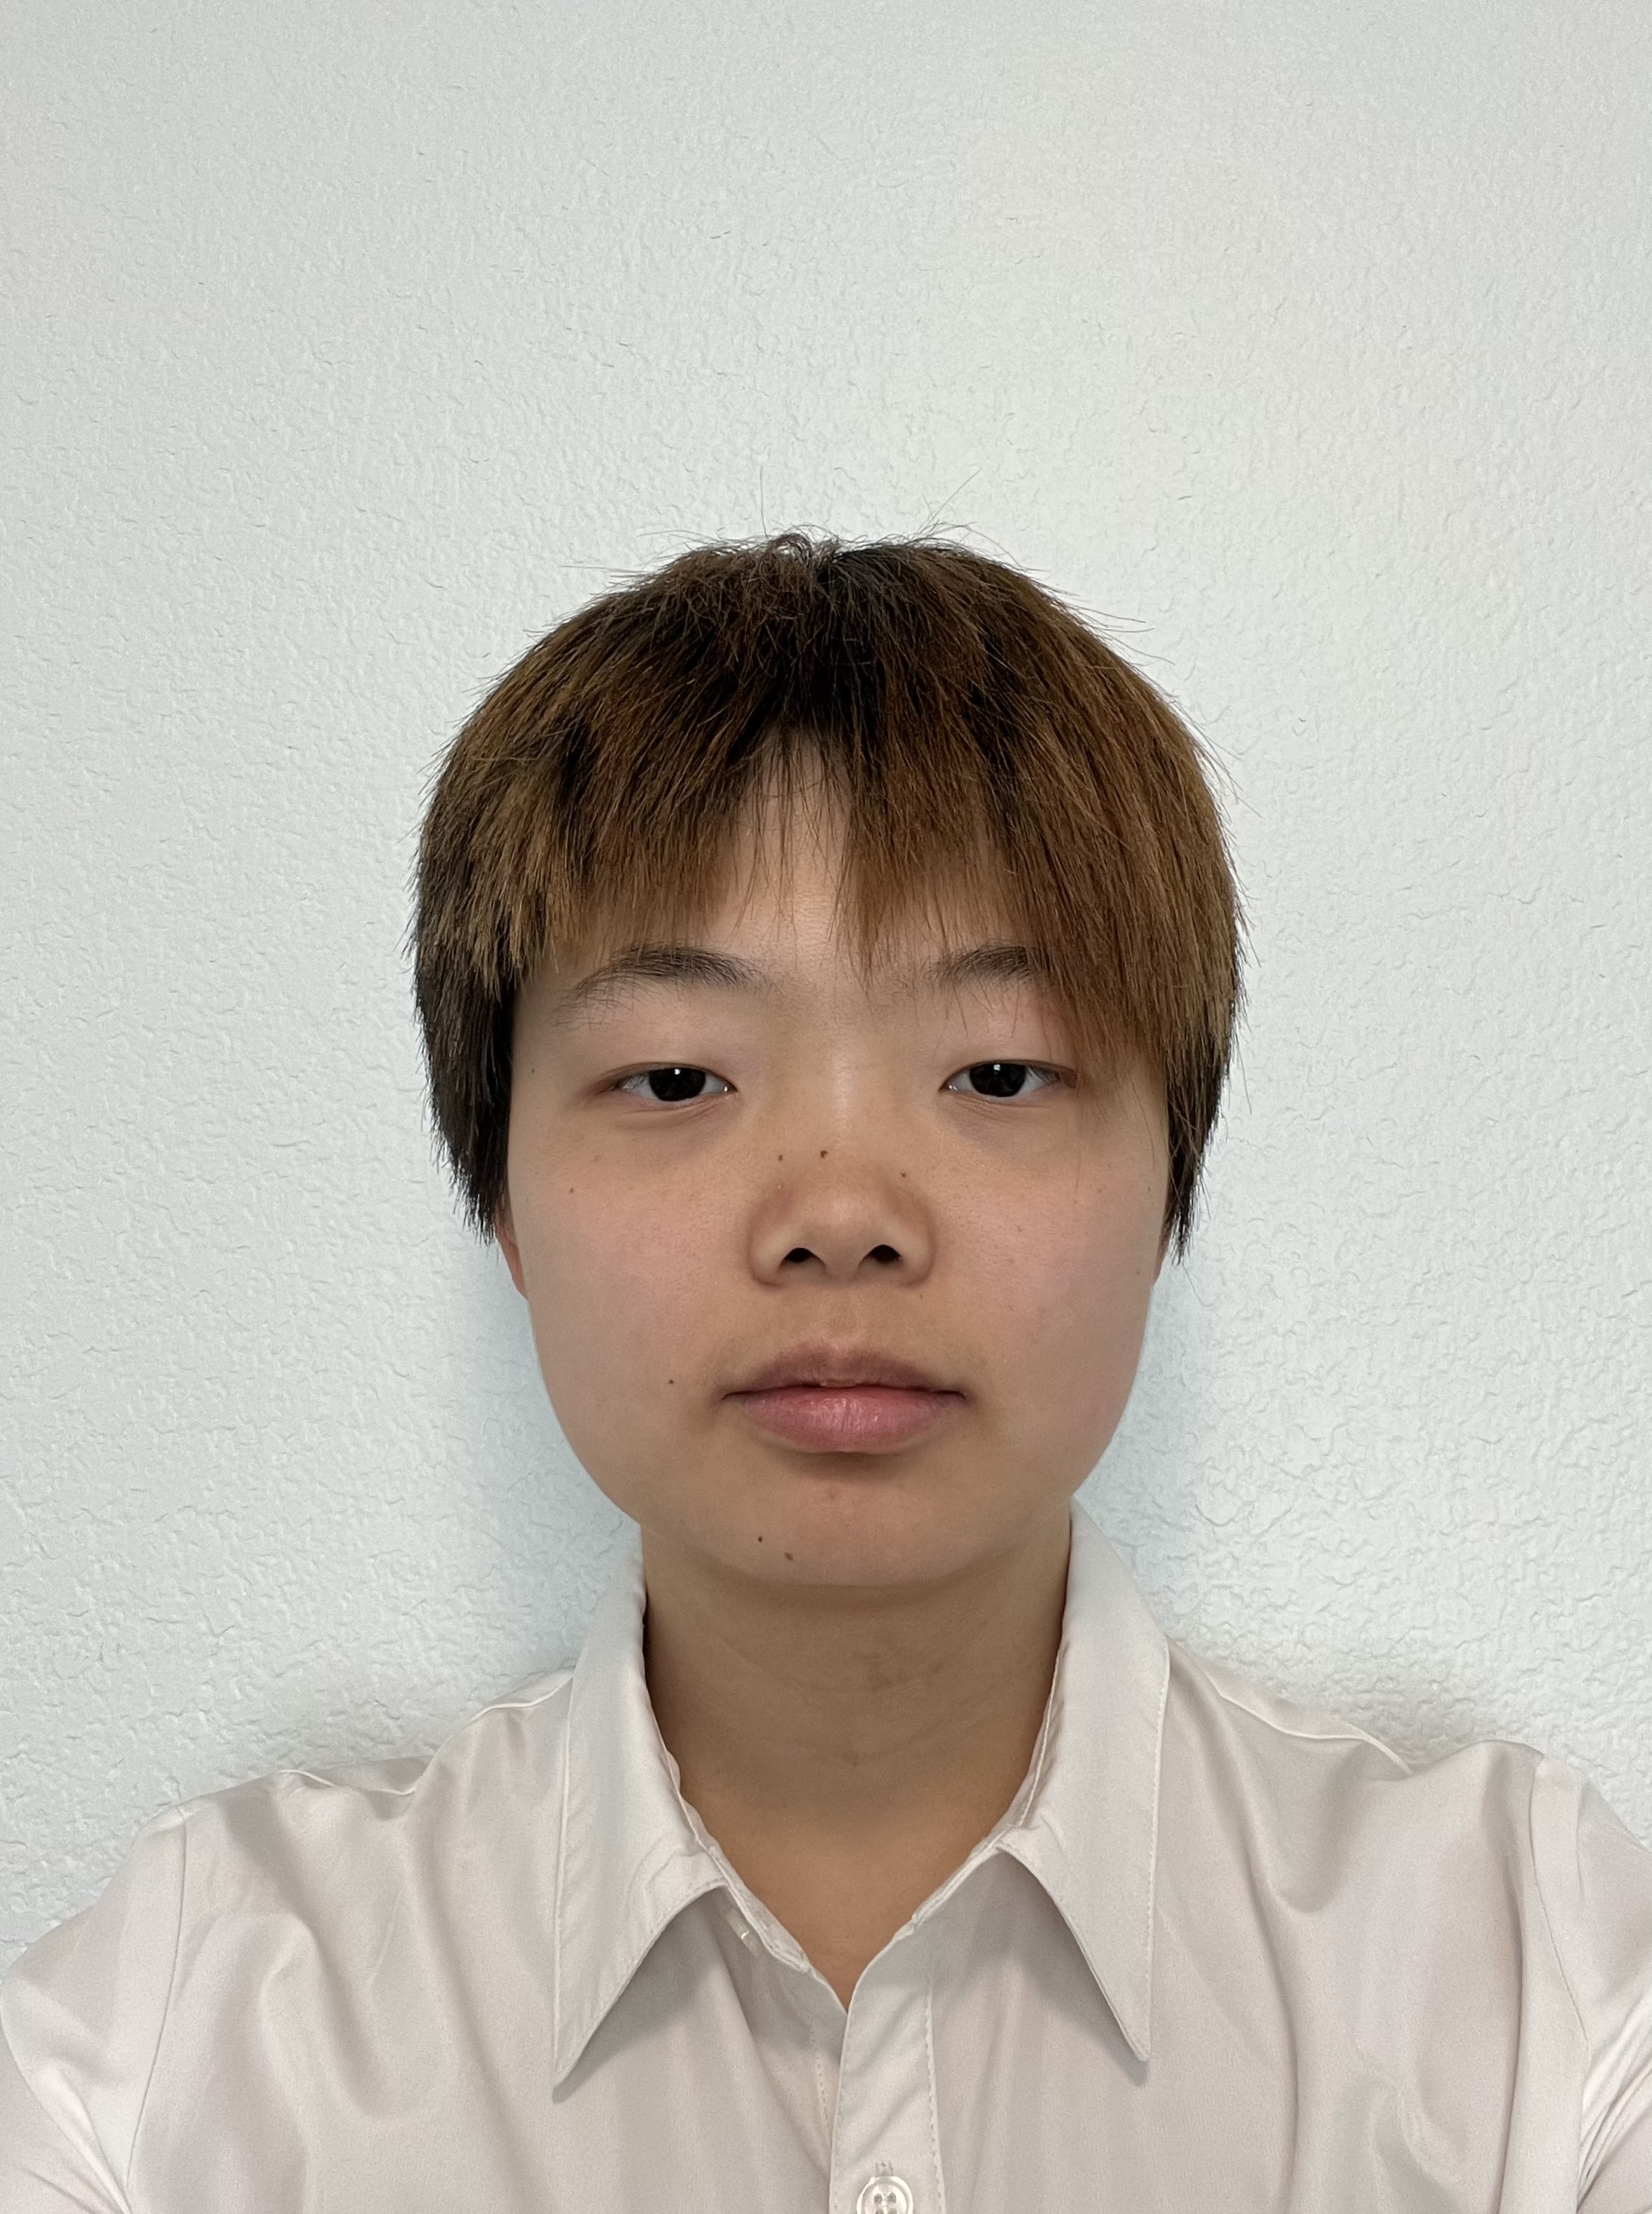


TEAM
Yuecheng Zhao
Yuecheng Zhao
Mira Stenger
Ruohan Huang
Trevor Lash
Ashwin Chembu

Slide 3
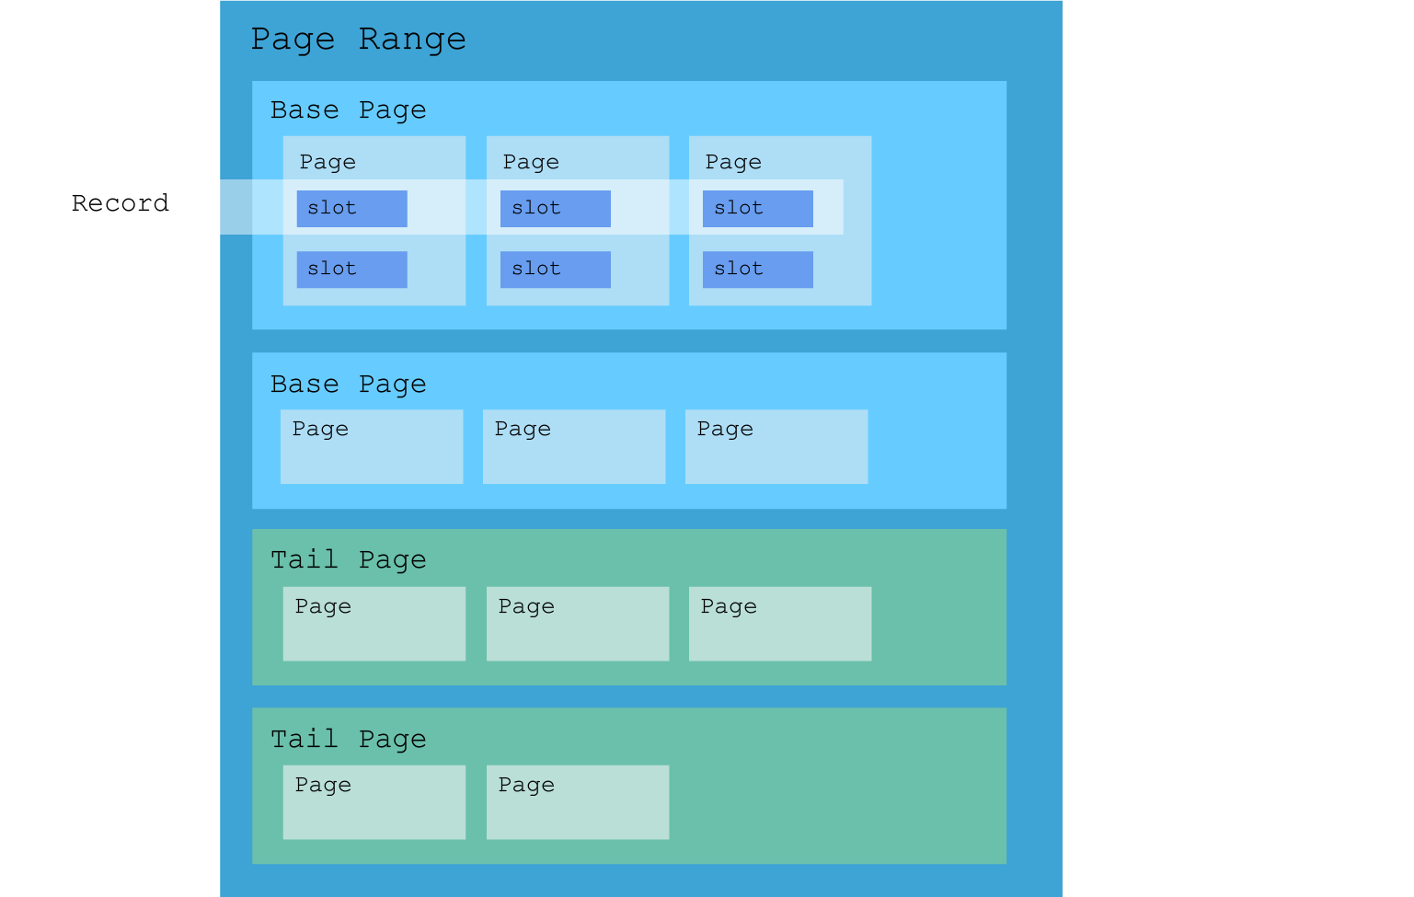
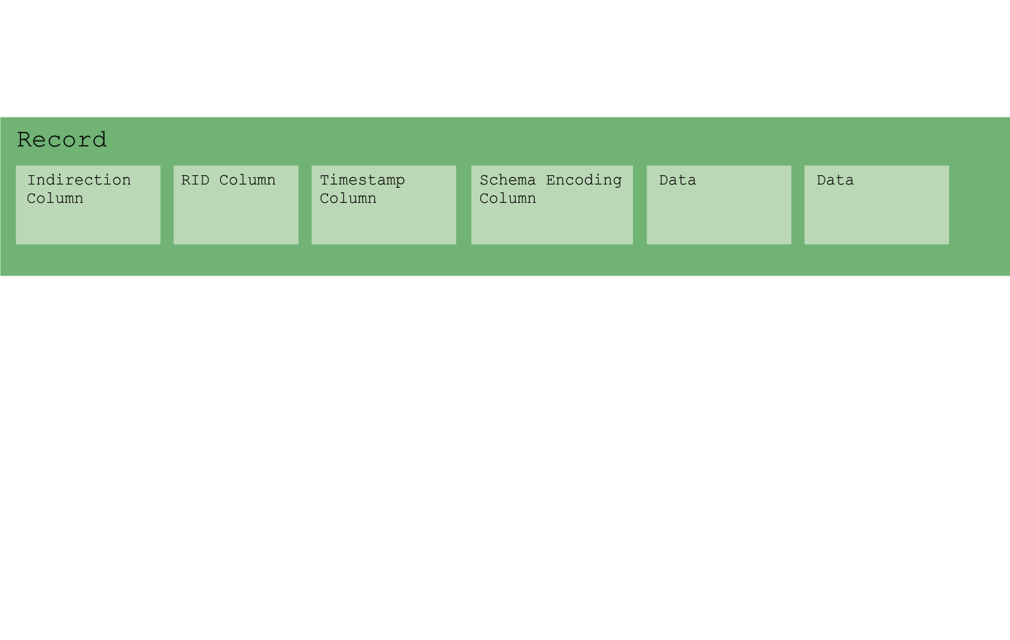
Data Model
16 February 2024
Page Range
main purpose of abstraction
Consists of base pages and corresponding tail pages
Updates for all records are appended to the same tail page
Page
4096 byte page size
fixed length records and packed page format

Slide 4
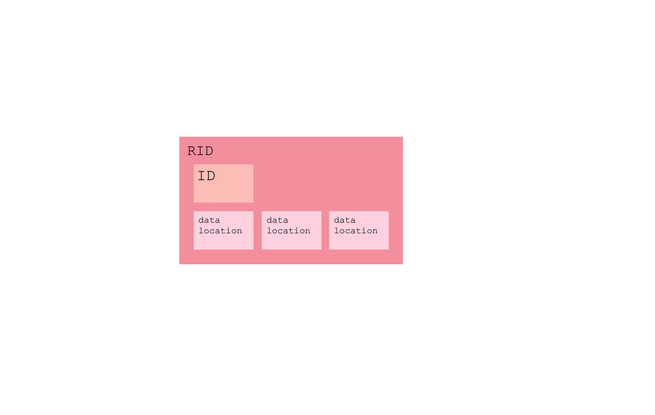
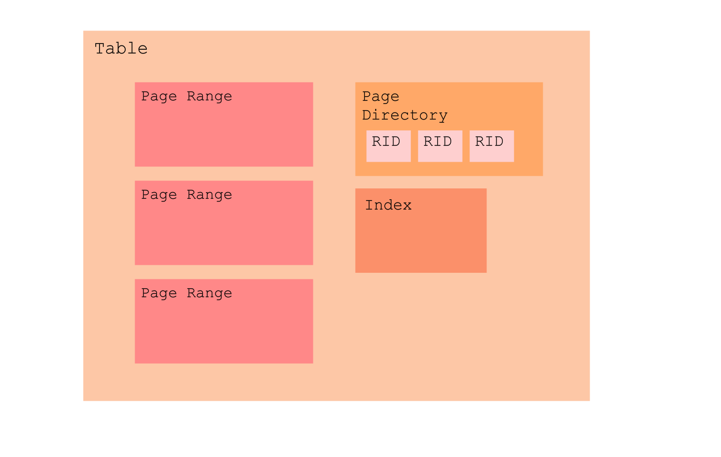
Bufferpool Management
16 February 2024
RID
contains a numerical ID
vector of pointers to metadata and data
Table
vector of page ranges to store data
page directory to map RID IDs to instances of the RID class
pointer to index

Slide 5
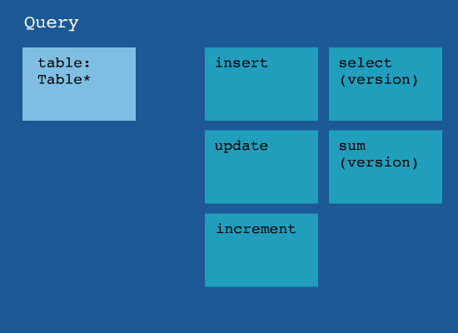
Query Interface
16 February 2024
Insert
calls the table's & table's index's insert function to write
Select
gets list of RID from index with most recent version(or given version) into record object, returns array of record objects
Update
locates RID to be updated
adds to tail page( or redirects)
updates indirection column and index
Sum
locates required range of RID using the index
navigates the indirection column(depending on versioning)
returns sum
Increment
gets the locates the key
iterates through the associated columns
increments it

Slide 6
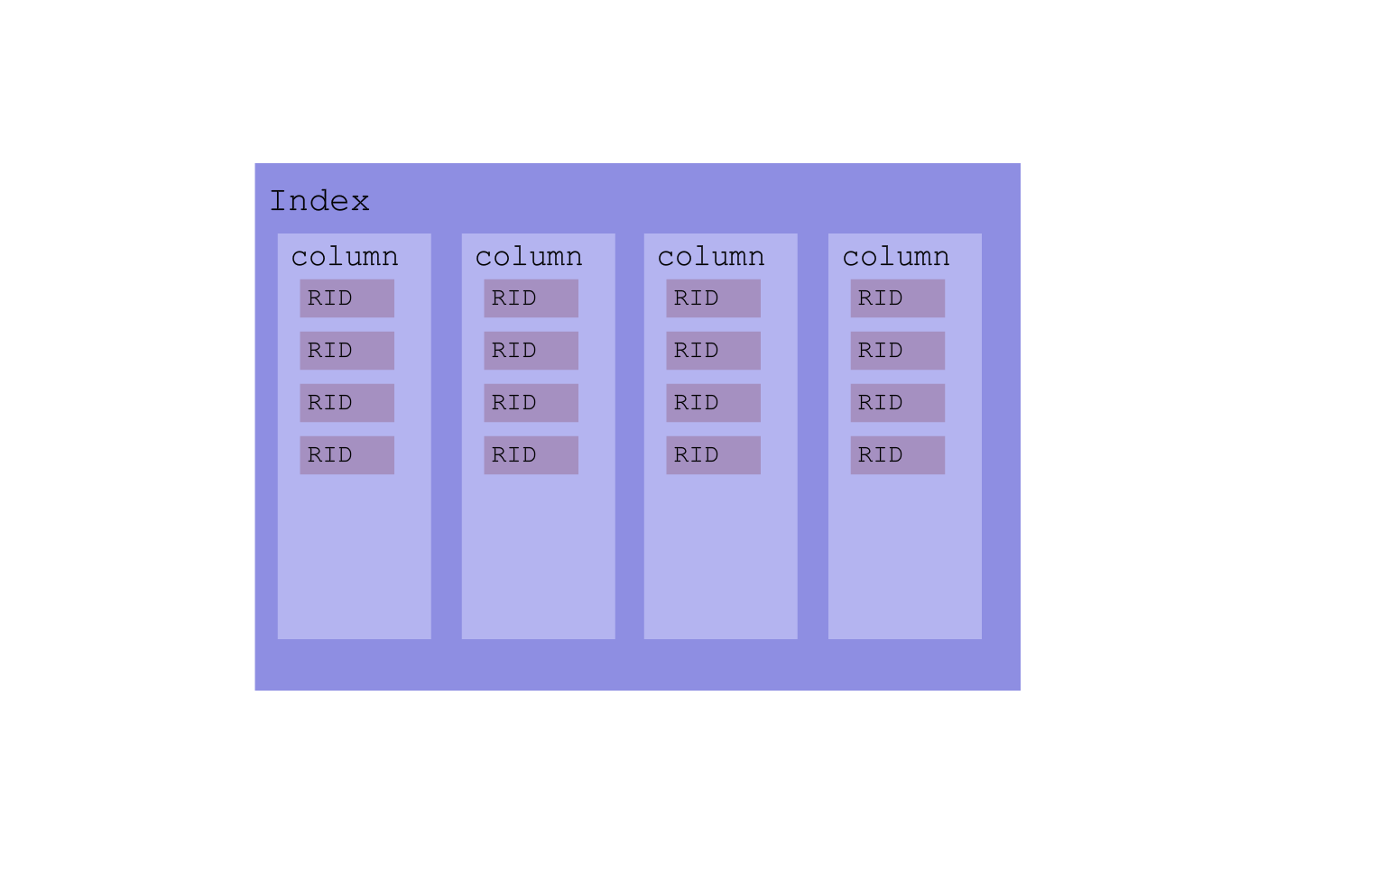
Index
16 February 2024
indexing
unordered multi-maps for efficient index storage and quick record location
key → data in the columns
value → RID
allows for indexing on each column(not just key)

Slide 7
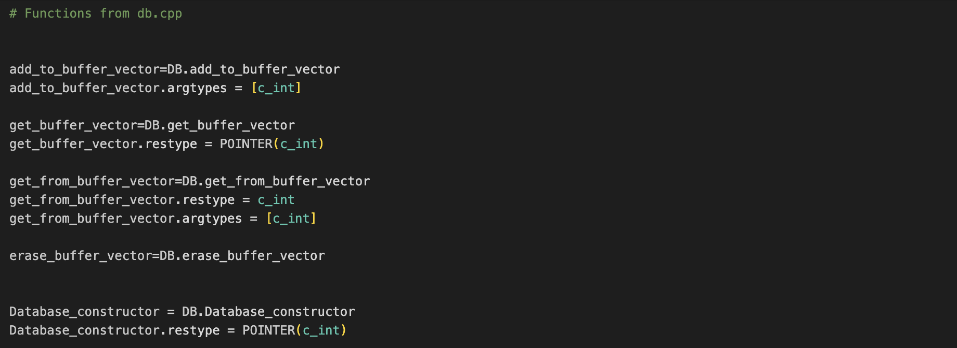
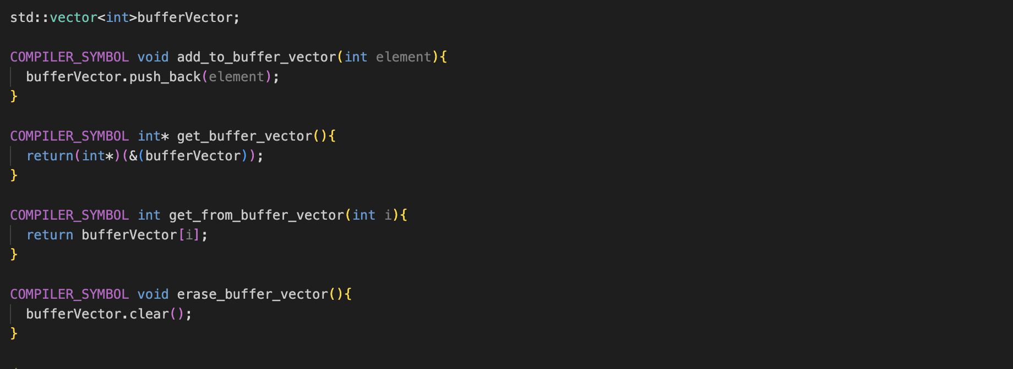
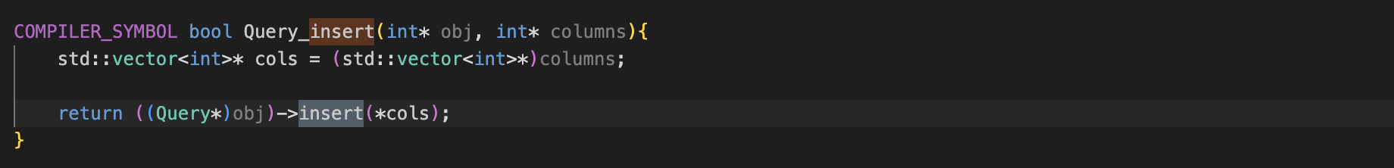
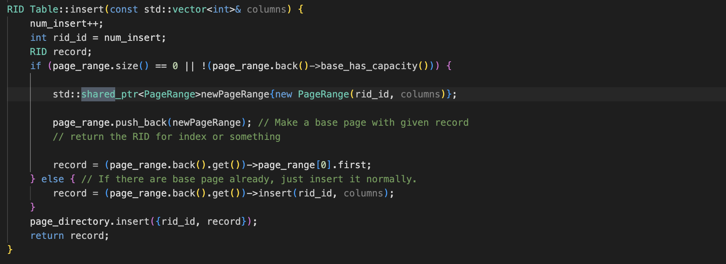
Python Wrapper
Compilation:
C++ functions are compiled into .so, .dylib, and .dll files using a makefile for ctypes access.
Ctypes restricts C++ functions to pointers and primitives.
Ctypes Workarounds:
Global arrays are used to parse Python lists in query.py and query.cpp.
The Query.insert method demonstrates data passing between Python and C++.
Lifetime Management:
Table class uses shared_ptrs for PageRanges to prevent memory leaks.
Ensures resources are not released until all references are gone.

Slide 8
Performance
Inserting 10K records | 0.12386
Updating 10K records | 0.170233
Selecting 10K records | 0.088323
Aggregate 10K of 100 record batch | 0.021175
Deleting 10K records | 0.005082

Slide 9
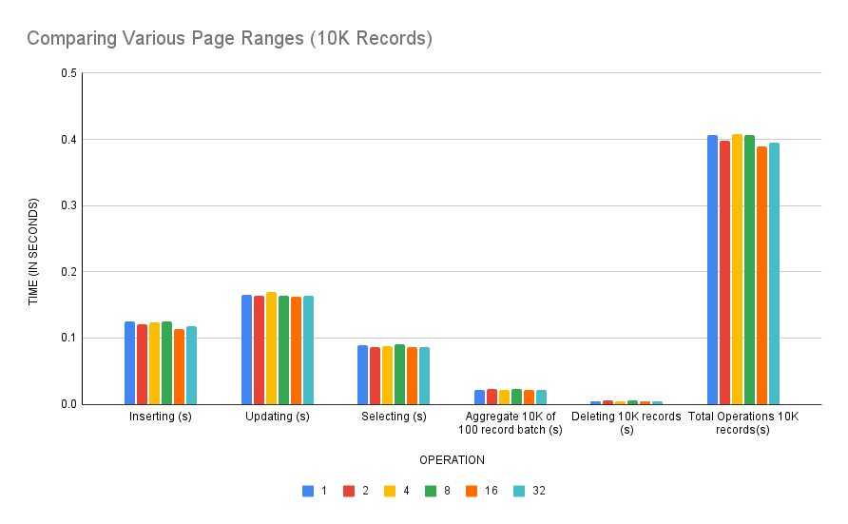
Graphs
16

Slide 10
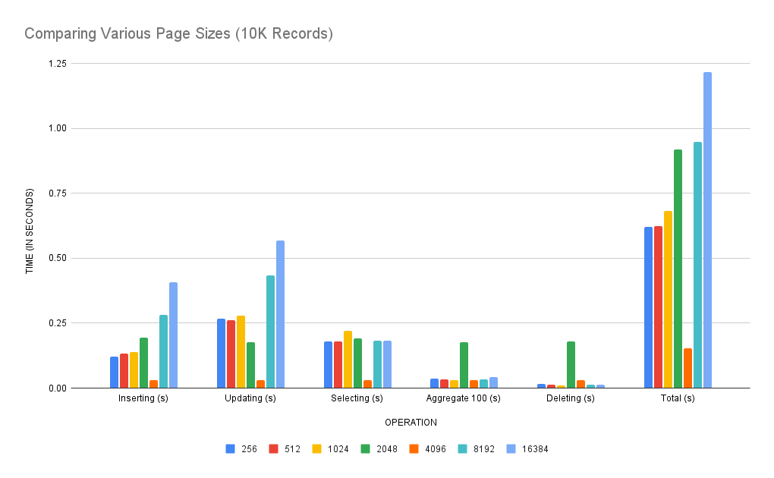
Graphs
4096

Slide 11
16 February 2024
Thank you

Slide 12



